Slide 1
Identity and Access Management in Cloud
Module 2 – Security
Dr Bijoy A Jose

Slide 2
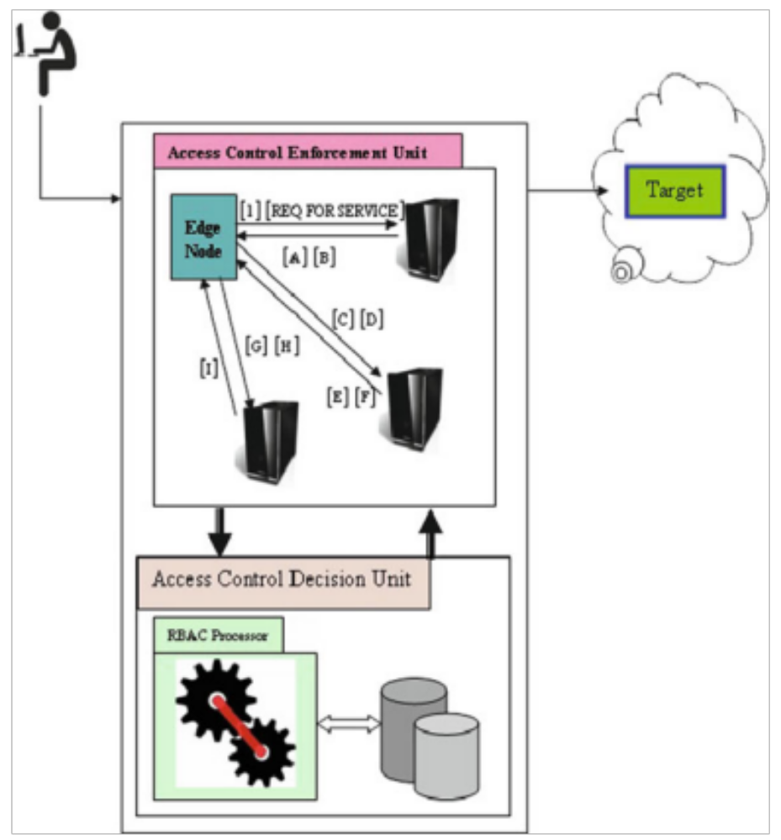
Communication between edge and cloud
The Kerberos model
Clients initially communicate with Access Control Management Unit (ACMU)
  Access Control Enforcement unit (ACEU)
    Authentication Server (AS)
    Ticket Granting Server (TGS)
    Service Server (SS)
  Access Control Decision unit (ACDU)

Slide 3
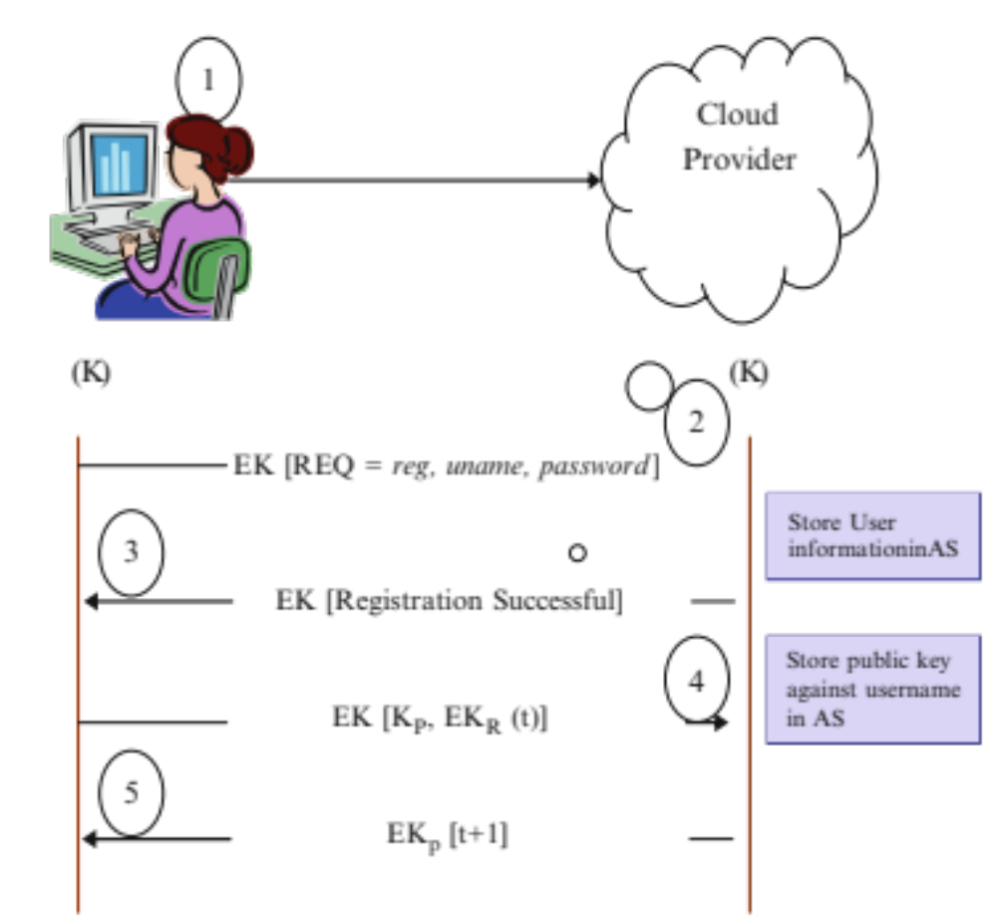
Registering into cloud
First request from User, Common secret key K is generated
User sends uname/pwd encryipted using K
Login info stored in AS of ACEU and acknowledgement is sent to User
A public-private key pair is generated and public key + timestamp is encrypted using private key is sent by the User
ACEU decrypts and stores public key in AS against User

Slide 4
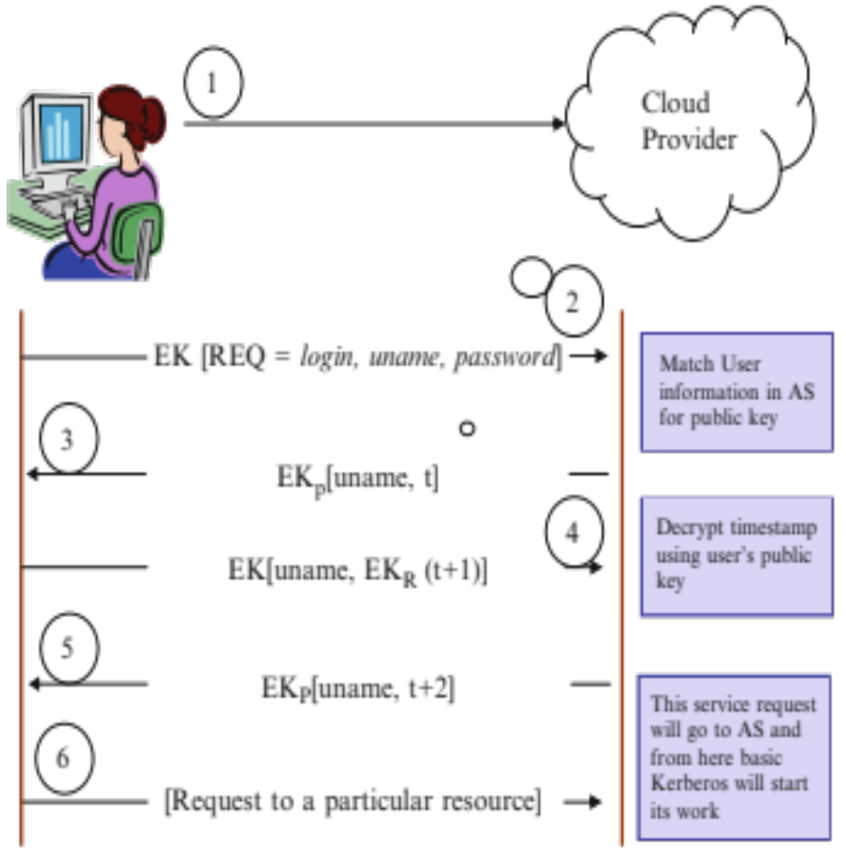
Logging into cloud
First request from User, Common secret key K is generated
User sends uname/pwd encrypted using K. AS will match user information and find public key stored earlier
Cloud sends uname with nonce t encrypted with User’s public key
User sends back a nonce t+1 to Cloud encrypted by User’s public key and Cloud returns the uname with t+2.
Now a resource is requested by User similar to Kerberos model using AS, TGS and SS
Notes:
Read about sending nonce and nonce+1

Slide 5
Other IAM topics
Hash Functions
Digital signatures
VPN
Digital certificates
SSL

Slide 6
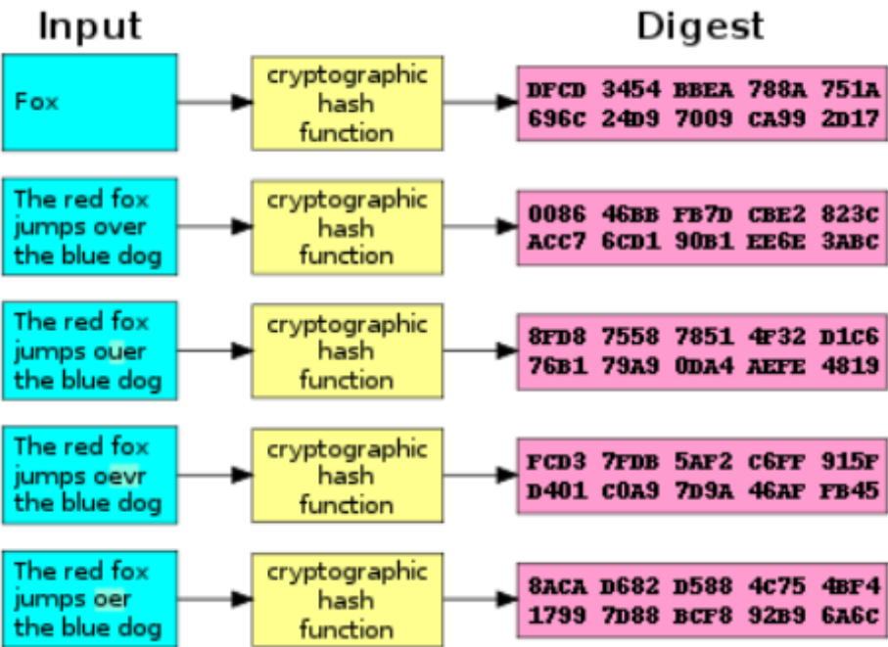
Hash Function
One-way encryption – can’t decrypt
  – Has no key
  – Hashing creates a fixed length message digest
Primary use is for message integrity
By comparing hash values, you can see if message sent = message received
Diffusion or substitution?

Slide 7
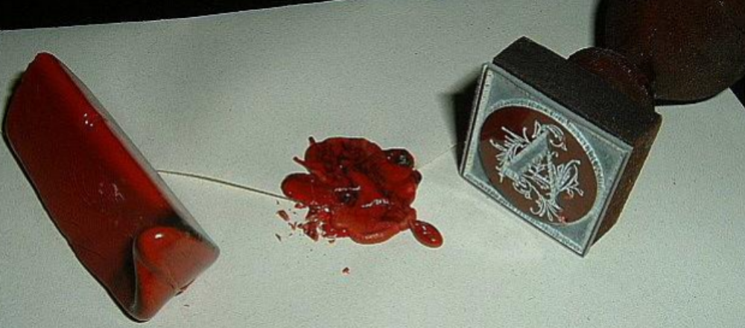
Digital Signature
A digital signature is a hash value that has been encrypted with the sender’s private key
A message can be
  Encrypted, which provides confidentiality
  Hashed, which provides integrity
  Digitally signed, which provides authentication, non- repudiation, and integrity
  Encrypted and digitally signed, which provides confidentiality, authentication, non-repudiation, and integrity

Slide 8
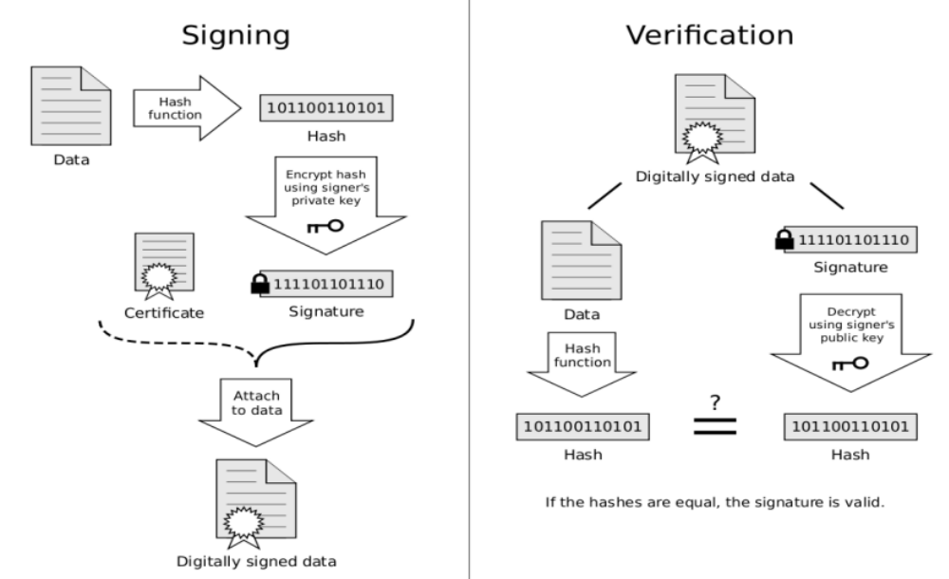

Slide 9
Virtual private network
A “tunnel” through the internet
– IPSec = IP Security protocol
A suite of protocols providing a mechanism to provide data integrity, authentication, privacy, and nonrepudiation for the classic Internet Protocol (IP)
Puts a “wrapper” around your message to keep it secure
Hides IP, connects you to a secure network, etc

Slide 10
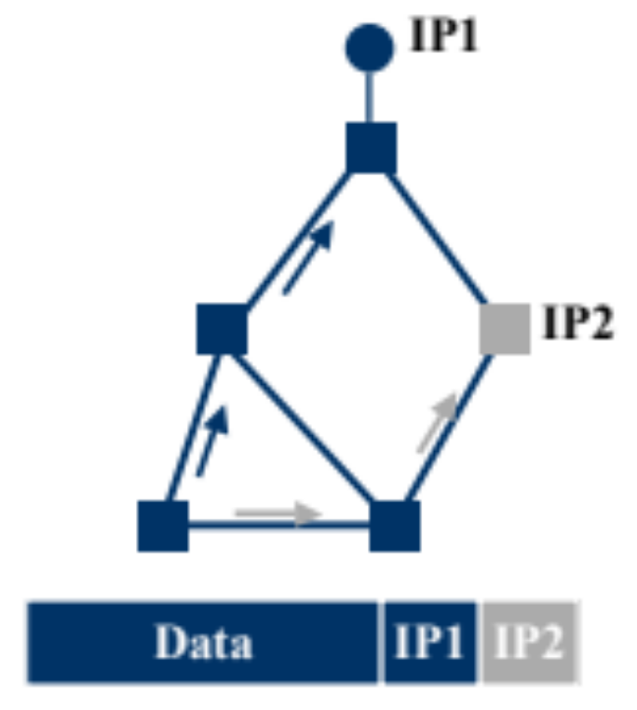
Virtual private network
Tunnelling
  Force a packet to go to a specific point in the network.
  Achieved by adding an extra IP header to the packet with a new destination address.
  Similar to putting a letter in another envelope

Slide 11
Digital Certificates
Digital certificate: Electronic document to verify that users and websites are who/what they claim to be
– Often used in email to verify sender
– Used on websites to indicate they’re authentic
Certificates usually contain a public key, a name, an expiration date, the name of the authority that issued the certificate, a serial number, any pertinent policies describing how the certificate was issued and/or how the certificate may be used, the digital signature of the certificate issuer, and perhaps other information

Slide 12
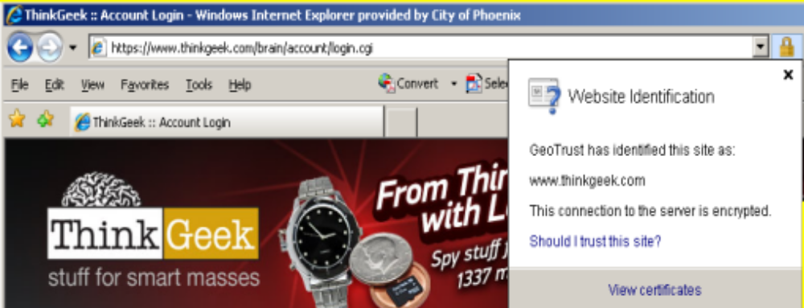
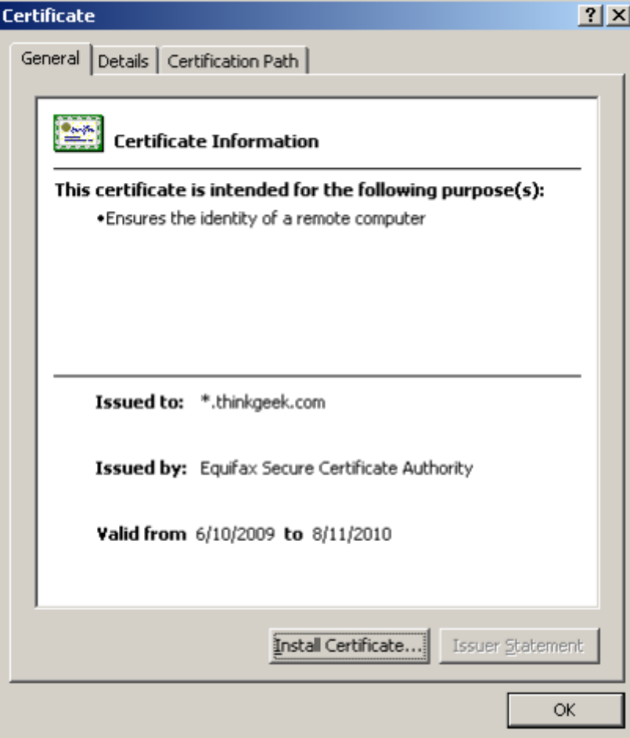
Digital Certificates
Used to
  Establish identity: Associate, or bind, a public key to an individual, organization, corporate position, or other entity
  Assign authority: Establish what actions the holder may or may not take based upon this certificate
  Secure confidential information (encrypting the session’s symmetric key for data confidentiality)
Look for
  Issued to site matches site name
  Issued by is reputable
  Certificate is valid
3 Major types of digital certificates

Slide 13
Secure Socket Layer
SSL provides endpoint authentication and communications privacy over the Internet using cryptography.
  Used for web browsing, email, faxing, other data transmission
  Can be used to create a tunnel for VPN
SSL uses public key crypto and digital certificates during an initial handshake used to authenticate the server
  The client and server then agree upon an encryption scheme
  Only the server is authenticated while the client remains unauthenticated. Mutual authentication requires PKI deployment to clients.

Slide 14
Other Digital Certificates
Code Signing Certificates are used to sign software or files that are downloaded over the internet.
  They are signed by the developer/publisher of the software.
  Purpose is to guarantee that the software or file is genuine and comes from the publisher it claims to belong.
Client Certificates or Digital IDs are used to identify one user to another, a user to a machine, or a machine to another machine.
  One common example is emails, where the sender digitally signs the communication, and the recipient verifies the signature.

